Slide 1


GMI Hackathon
Alexander
Brad

Slide 2
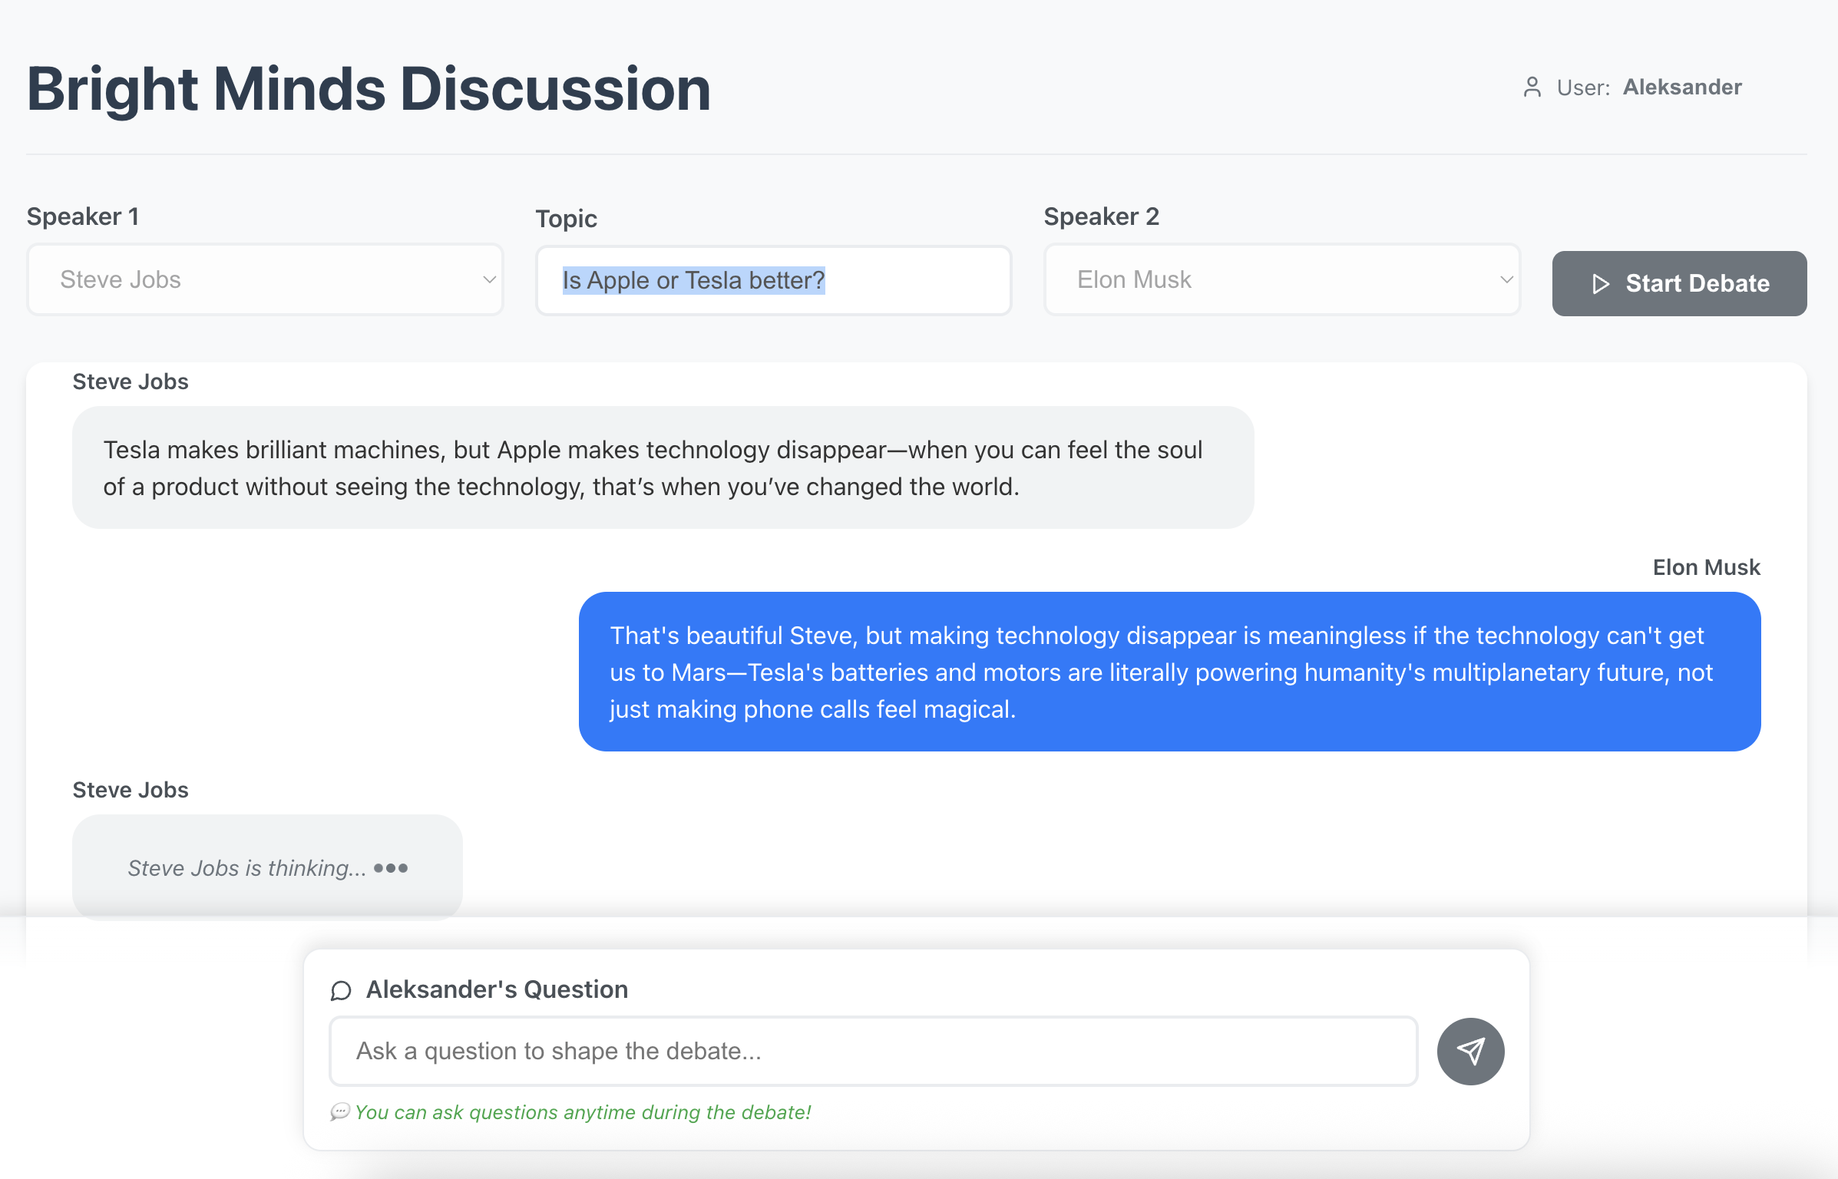

Slide 3
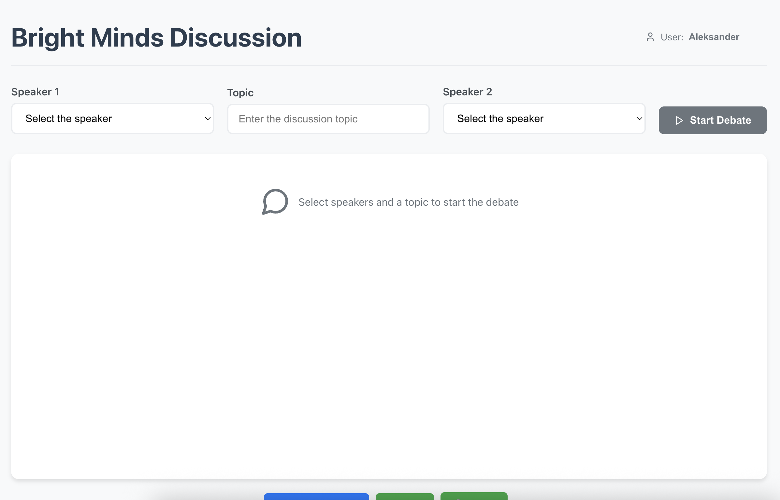

Slide 4
What is Bright Minds Discussion?
Bright Minds Discussion is a web app that simulates AI-driven debates between influential figures like Steve Jobs and Elon Musk.
Built for the GMI Hackathon using:
- Model: moonshotai/Kimi-K2-Instruct
- Text-to-Speech: elevenlabs.io
- Hosted via GMI Cloud

Slide 5
Core Features
- Select two speakers and a topic for debate
- Start organic, dynamic 5–10 minute AI-generated conversations
- User-injected questions mid-debate
- Custom speaker behavior via prompt engineering
- Speaker impersonation with insights from books, blogs, interviews

Slide 6
User Experience Flow
1. Choose Speaker 1 and Speaker 2
2. Input the topic
3. Click 'Start Debate'
4. Watch the debate unfold live
5. Ask questions to guide the conversation

Slide 7
Speaker Behavior & Design
- Speaker personas fine-tuned via prompt engineering
- Replies limited to ~2–5 sentences for engagement
- Behavior modeled on real-world rhetoric of speakers
- Responses delayed slightly for realism

Slide 8
Built With
- GMI Cloud for model inference
- moonshotai/Kimi-K2-Instruct (LLM)
- elevenlabs.io for text-to-speech
- Qt6 frontend for desktop prototype (optional)
- Python backend using `requests`, `dotenv`, and subprocess integration

Slide 9
What's Next?
- Audio podcast export with speaker voices
- Multi-speaker debates and moderator role
- GMI-hosted leaderboard of best debates
- Share debates as clips or transcripts

Slide 10
Thank You!
Built for the GMI Hackathon
Bright Minds, Bold Ideas.

